Slide 1
LSST:
Echo storage pilot
June 21th 2021
Joshua Kitenge

Slide 2
Introduction
Project: Curating and serving astronomy survey images on the Echo (S3) Object Store
Aims:
Develop necessary scripts to ingest survey images into Echo storage and then transfer data across while measuring performance.
Test that data rights can be enforced correctly, restricting access to image data on Echo, to a defined set of astronomers.
Test simple workflows from both local (RAL) and remote (Edinburgh) VMs on Openstack Clouds.
If time permits I’ll would try scaling up the test workflows to see how performance changes.
Joshua Kitenge, June 21th 2021

Slide 3
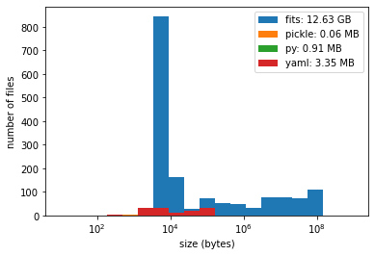
Data ingestion: Upload speed test using rclone
Dataset: LSST Science pipeline tutorial (converted into a gen 3 format in a local repository)
rclone: S3 tool for copying data into and out of S3 storage (rclone was for it parallel uploads)
Single transfers : 20 MB/s, 20MB/s and 8 MB/s for the LSST Openstack , Edinburgh Somerville and Cambridge DIRAC HPC VMs respectively
50 parallel transfers: 202 MB/s , 217 MB/s and 47 MB/s for the LSST Openstack , Edinburgh Somerville and Cambridge DIRAC HPC VMs respectively
File size distribution:
The Highest peak is around ~10 kB
The mean file size of whole data ~ 8 MB
The median file size of whole data ~ 8 kB
Note: Performances may vary to the load of the node whilst preforming the tests
More transfer speed tests

Slide 4
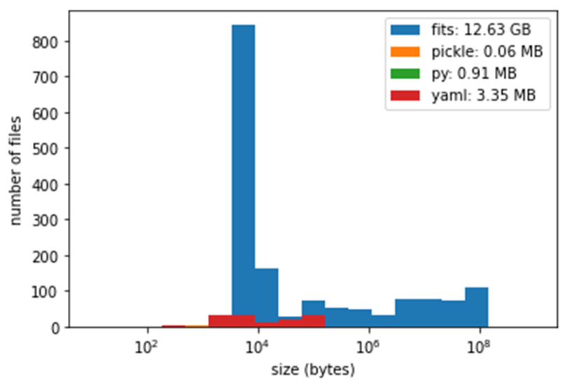
Data ingestion: Upload speed test using butler Python API
Dataset: LSST Science pipeline tutorial (converted into a gen 3 format in a local repository)
Butler Python API: exporting the data and importing it into a new gen 3 butler repository
The export function creates configurations to find the data within the local repository
The import function also populates a SQL registry as well as copying data into to the new butler repository (gen 3)
Doesn’t support parallel uploads into S3 echo object store
Upload speeds: 11MB/s and 6MB/s for the LSST Openstack and Edinburgh Somerville VMs
Note: Performances may vary to the load of the node whilst performing the tests
More transfer speed tests

Slide 5
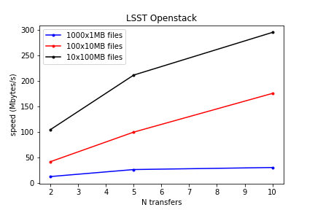
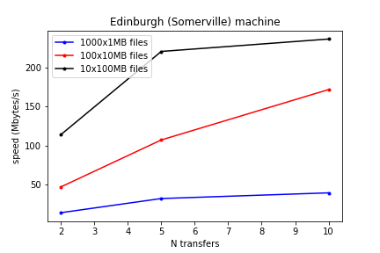
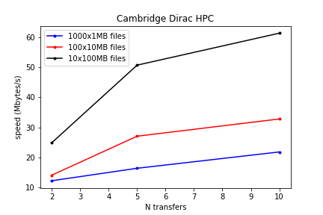
rclone upload speed tests
Butler Python API speed tests
LSST-IR-FUSION:
Data ingestion

